Slide 1

Hate Speech Detection
Data Science Intern at Data Glacier
Name:Manhui Zhu
Email: zmanhui09@outlook.com
Country: California, US
Date: 20-July-2024

Slide 2
Outline
Problem Statement
Data Information
Data Preprocessing
Exploratory Data Analysis (EDA)
Feature Extraction
Model Building
Model Performance Evaluation
Application Deployment
Conclusion

Slide 3



Problem Statement
Hate speech: any type of verbal, written or behavioral communication that attacks or uses derogatory or discriminatory language against a person or group based on their religion, ethnicity, nationality, race, color, ancestry, sex or another identity factor. To detect the hate speech from various free speech, we will take you through a hate speech detection model with Machine Learning and Python. And we will deploy our ML model on Flask to create a web application.
Hate Speech Detection is generally a task of sentiment classification. A model that can classify hate speech from a certain piece of text can be achieved by training it on a dataset that is generally used to classify sentiments. For the task of hate speech detection model, we will use the Twitter tweets to identify tweets containing Hate speech.

Slide 4
Name of dataset | hate_speech.csv
Total number of observations | 31962
Total number of features | 3
Base format of the file | .csv
Size of the Data | 2.95 MB
Data
Information
The dataset has three features:
id: data type int64
label: data type int64
tweet: data type object
There is no missing value in the dataset.

Slide 5
Data Preprocessing
4 main steps to transform raw text into a structured format(note that some vectorizer like TF-IDF includes this procedure):
1. Text Cleaning
Lowercasing: A to a
Removing User Mentions: @Users
Removing URLs
Removing Special Characters: keep only letters and whitespace
Removing all leading and trailing whitespace
2. Removing Stop Words (high-frequency words but not contribute to the meaning and context of the sentence)
3. Tokenization: split text in unit of words
4. Lemmatization: reduce words to their base or root
@eli_t1 the weather is wonderful!!!😄
weather wonderful

Slide 6
EDA
1. Number of words in each words before/after removing stop words
2. Most frequent words in hate/non-hate speech
3. Word cloud for hate/non-hate tweet
4. Resampling data to solve imbalance problem of data distribution

Slide 7
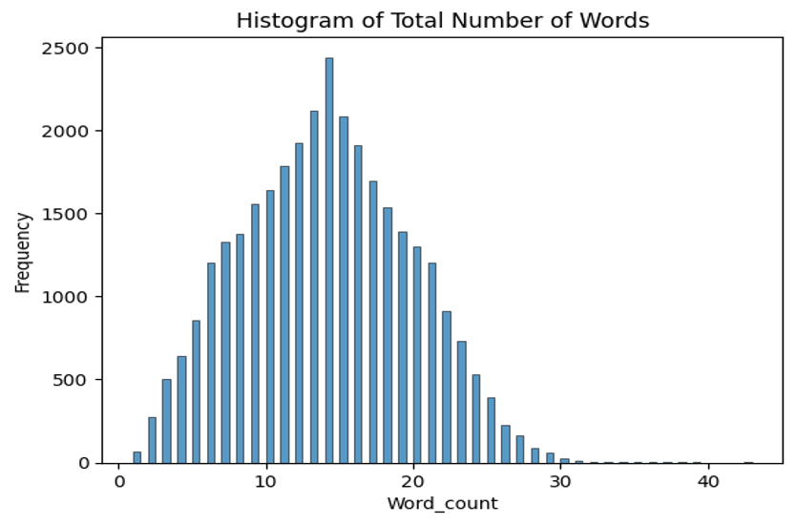
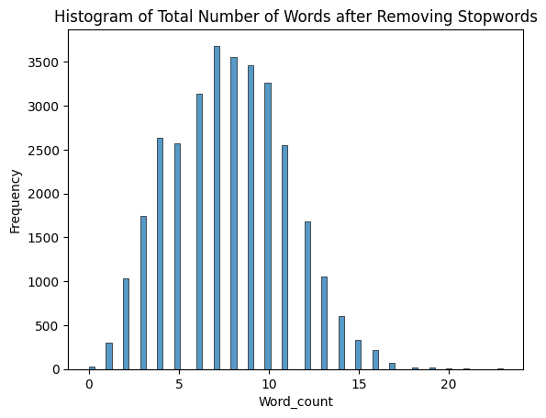
EDA - Number of words before/after removing stop words
We check total number of words in each tweets and find that more than half of tweets contain between 10 and 20 words. After removing the stop words in corpus, most tweets contain between 5 and 11 words.

Slide 8
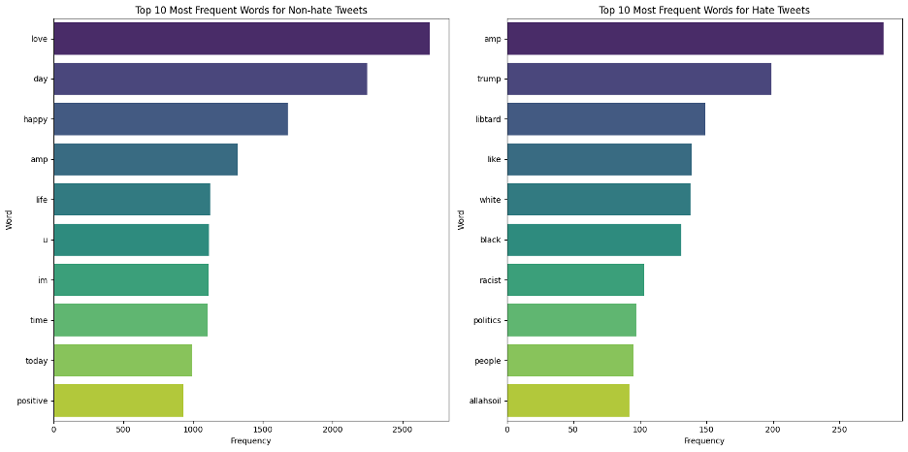
EDA - Top 10 frequent words in hate/non-hate tweets

Slide 9
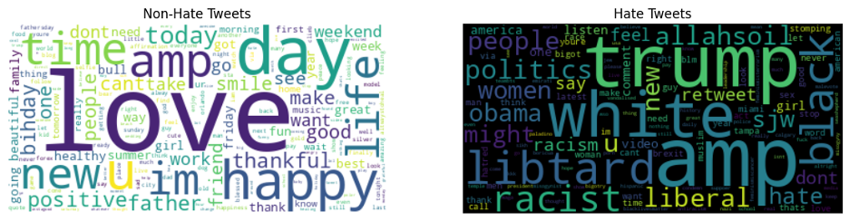
EDA - Number of words before/after removing stop words
In non-hate tweets, ‘love’, ‘time’, ‘day’, ‘happy’, ‘life’ are high frequent words These words are either positive or at least neutral.
In non-hate tweets, ‘trump’, ‘white’, ‘politics’, ‘black’, and ‘racist’. These words are associated with politics and race, which is usually controversial and prone to disputes.

Slide 10
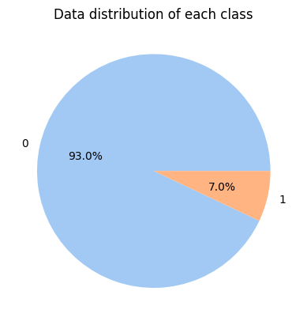
EDA - Resampling data to solve imbalance problem of data distribution
There are 29720 non-hate tweets and 2242 hate tweets, which is imbalanced. The models trained on imbalanced data often underfits the minority class and is biased towards the major class.
To avoid this problem, we resample the minority samples (label = 1) with replacement so that it reaches the same number of samples of majority class (label = 1). After resampling:
Number of non-hate samples: 29720
Number of hate samples: 29720
Total number of observations: 59440

Slide 11
Bag of Words (BoW)
TF-IDF
Word Embeddings (Word2Vec)
BERT
Feature
Extraction

Slide 12
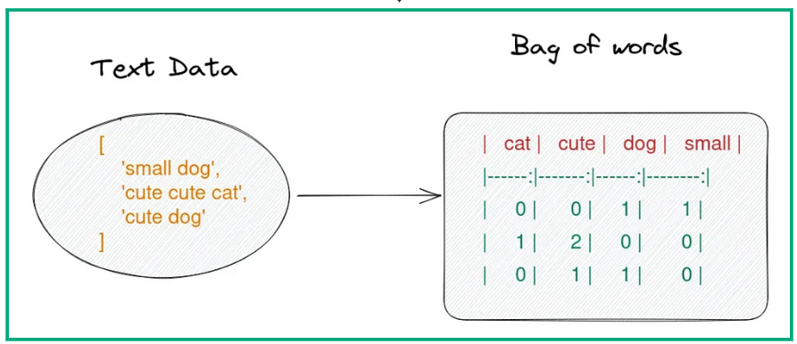
Bag of Words (BoW)
This method converts text into a matrix of token counts (numerical representations), ignoring grammar and word order but keeping multiplicity. The intuition behind this method is that similar text fields will contain similar kind of words, therefore having similar bag of words. It has three steps:
Tokenization: Splitting the text into individual words and tokens
Vocabulary: Creating a set of unique words (tokens) from the entire text corpus
Vectorization: Converting each document into a vector where each dimension corresponds to a word from the vocabulary and the value represents the word's frequency in the document.

Slide 13



TF-IDF (Term Frequency - Inverse Document Frequency)
This method evaluates the importance of a word in a document relative to a collection of documents (corpus), reducing the weight of common words.
Term Frequency (TF): Measures how frequently a term occurs in a document. Terms that appear more frequently within a document are more important.
Inverse Document Frequency (IDF): Measures how important a term is within the entire corpus. It helps reduce the weight of terms that occur very frequently in many documents and increase the weight of terms that occur rarely.
The TF-IDF score is the product of TF and IDF:

Slide 14
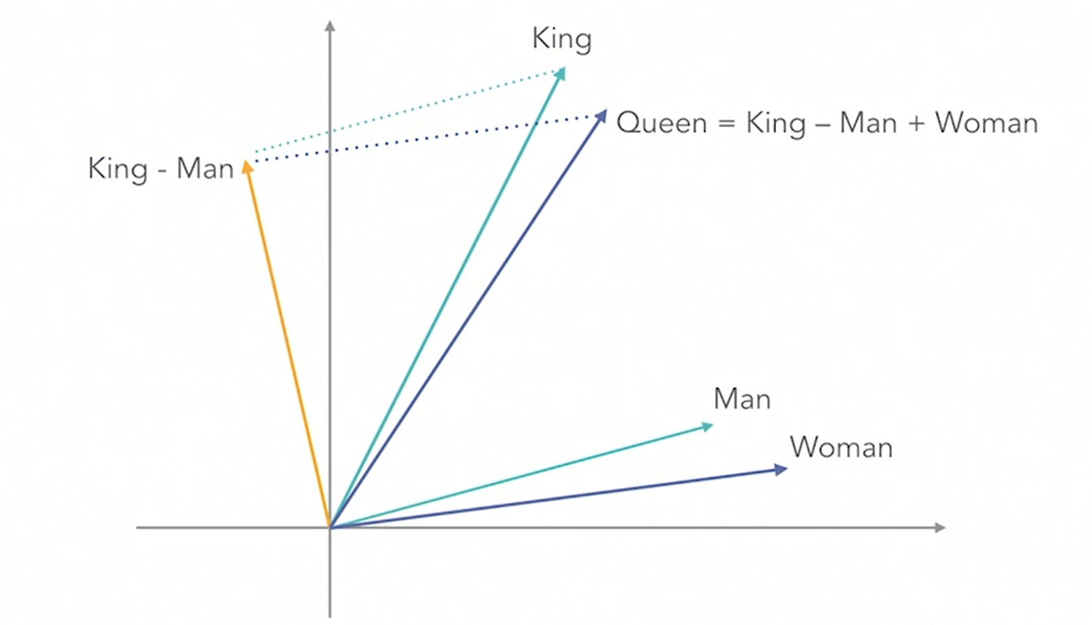
Word Embeddings (Word2Vec)
This method represents words in a dense vector space, capturing semantic relationships. Words with similar meanings are located close to each other in this vector space.
It is typically trained on large text corpora using neural networks. Here, we use the pre-trained `Word2Vec` models developed by Google (`GoogleNews-vectors-negative300.bin`)
Twitter language is full of slang, abbreviations, and emojis. Word2Vec can learn these informal and evolving expressions, leading to accurate detection of hate tweets.
Example:
The vector of King
– The vector of Man
+ The vector of Women
= The vector of Queen

Slide 15
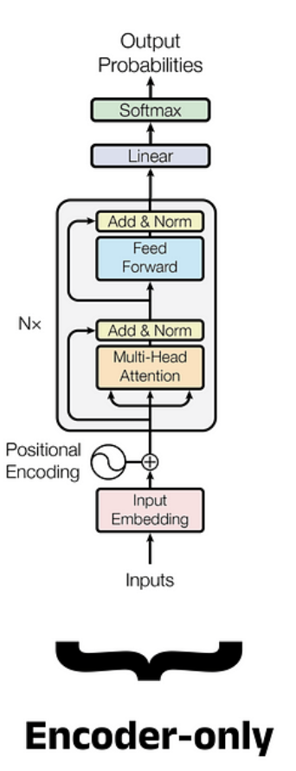
BERT (Bidirectional Encoder Representations from Transformers)
BERT is a pre-trained transformer-based model. It can understand the context of a word in a sentence, reading text in both direction (left-to-right and right-to-left).
Transformer: it applies self-attention mechanism, allowing the model to weight the importance of different words in a sentence and capture long-range dependencies.
Positional Encoding: it provides information about the position of each word in the sequence.
Encoder: it processes the input text and generates a contextualized representation. The original transformer model consists of an encoder and a decoder, BERT only use the encoder.
1) Multi-head self-attention mechanism: focus on different parts of the sentence simultaneously, capturing various aspects of the relationships between words.
2) Feed-Forward Neural Networks (FFNN): introduces non-linearities and transforms the feature extracted by the self-attention mechanism, increasing the model's capacity to capture intricate relationships in the data.
3) Add and normalize operations for layer normalization and residual connections: it stabilizes training and allows gradients to flow through the network more effectively.

Slide 16
Model Building & Training
Random Forest
XGBClassifier
LSTM
Transformer (Fine-tune BERT)

Slide 17
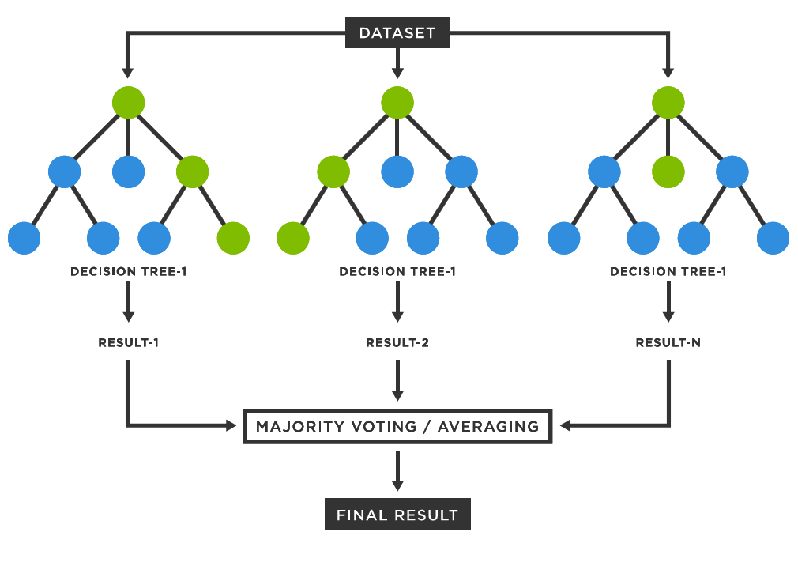
Random Forest
Random Forest model creates multiple decision trees using different subsets of the data (bootstrapping technique: sampling with replacement) and takes a majority vote (for classification task).
At each split in a tree, a random subset of features is selected to find the best split, which introduces randomness and reduces overfitting.
We add parameter `n-estimators = 100` when constructing the model. It means that the random forest will consist of 100 individual decision trees.

Slide 18
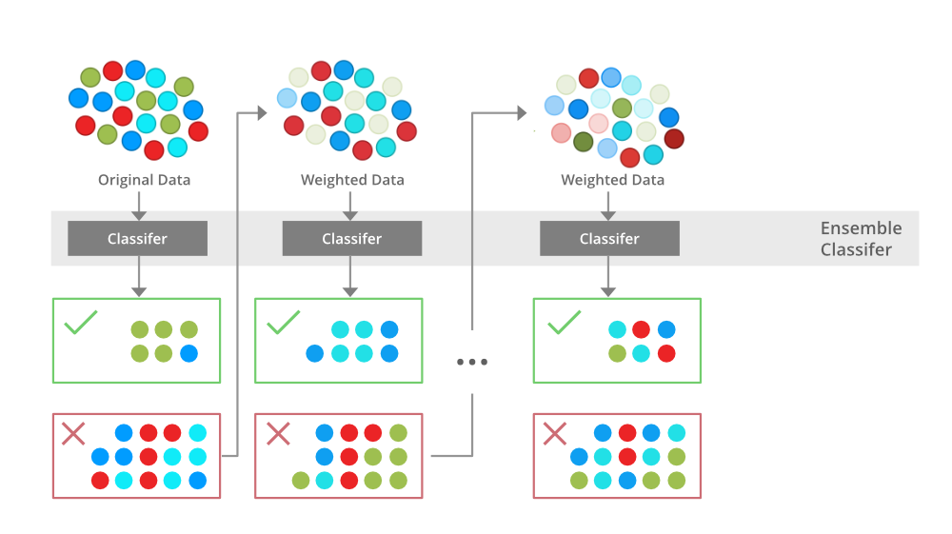
XGBClassifier
The XGBClassifier is part of the XGBoost (Extreme Gradient Boosting) library, which is gradient-boosted decision trees.
This model sequentially builds trees where each tree tries to correct the errors of the previous trees.
It optimizes an objective function using gradient descent.
Different from random forest, all features are considered at each split, but the algorithm focuses on features that reduce the loss the most.
We also add parameter `n-estimators = 100` in model construction.
Each tree is trained on a random subset of the training data, it contributes to the overall robustness and performance of the model.

Slide 19
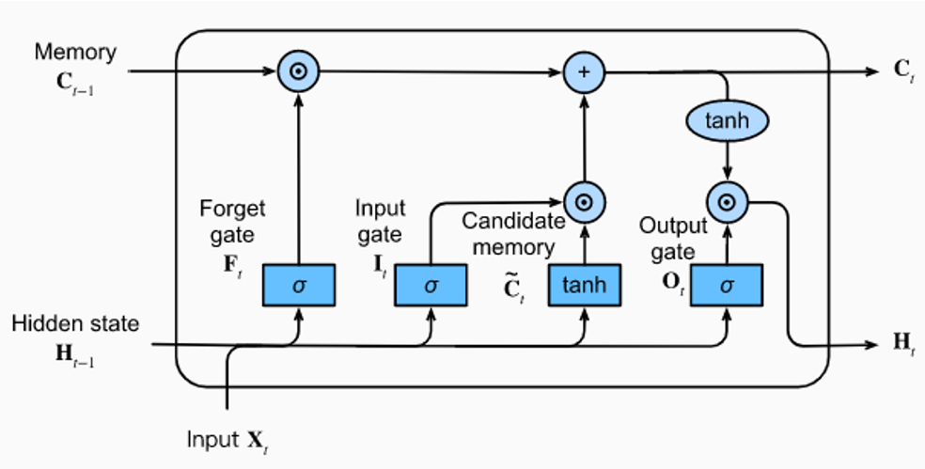
LSTM (Long Short-Term Memory)
LSTM models is a neural network that can capture and understand the context and dependencies within text sequences.
It is introduced to address the vanishing gradient problem of RNNs (Recurrent Neural Network).
LSTM networks use memory cell structure that can maintain information over long periods.
It uses gating mechanisms to control the flow of information:
1) Input gate: add/update new information
2) Forget gate: forget irrelevant information
3) Output gate: pass the updated information
Long-term Memory
Updated Long-term Memory
Previous Output
Current Output

Slide 20
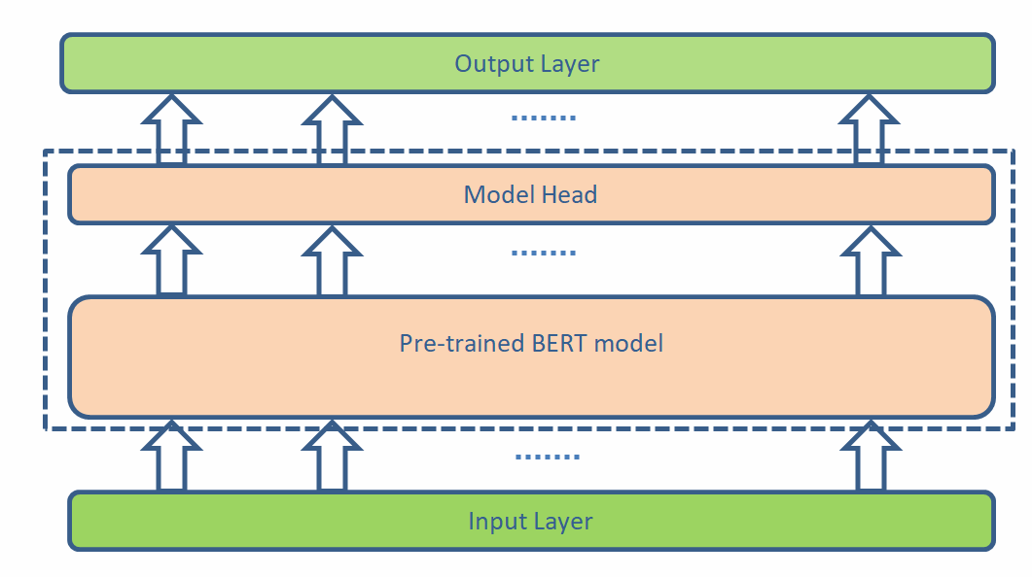
Transformer (Fine-tune BERT)
Transformer (BERT) model uses self-attention mechanisms to understand the context of a word based on its surrounding words.
Here we fine-tune the pre-trained BERT model on our specific tweet speech dataset and hate speech detection task.
We update weights and of the pre-trained BERT model.
We use `TFBertForSequenceClassification` class when loading the model to adapt the BERT model by adding a classification head (usually a linear layer) on top of the BERT encoder.

Slide 21
Train Test Split
For Random Forest and XGBClassifier:
Training set: 80%, Test set: 20%
For LSTM:
Training set: 80% (In each epoch, randomly select 20% of training set as Validation set), Test set 20%
Training stops at 10th epoch
For Transformer (Fine-tune BERT):
Training set: 60%, Validation Set 20%, Test set: 20%
Learning rate = 0.00005
Training stops at 5th epoch

Slide 22
Confusion Matrix
Accuracy, F1-Score, ROC-AUC Score
ROC Curve
Model Performance Evaluation

Slide 23
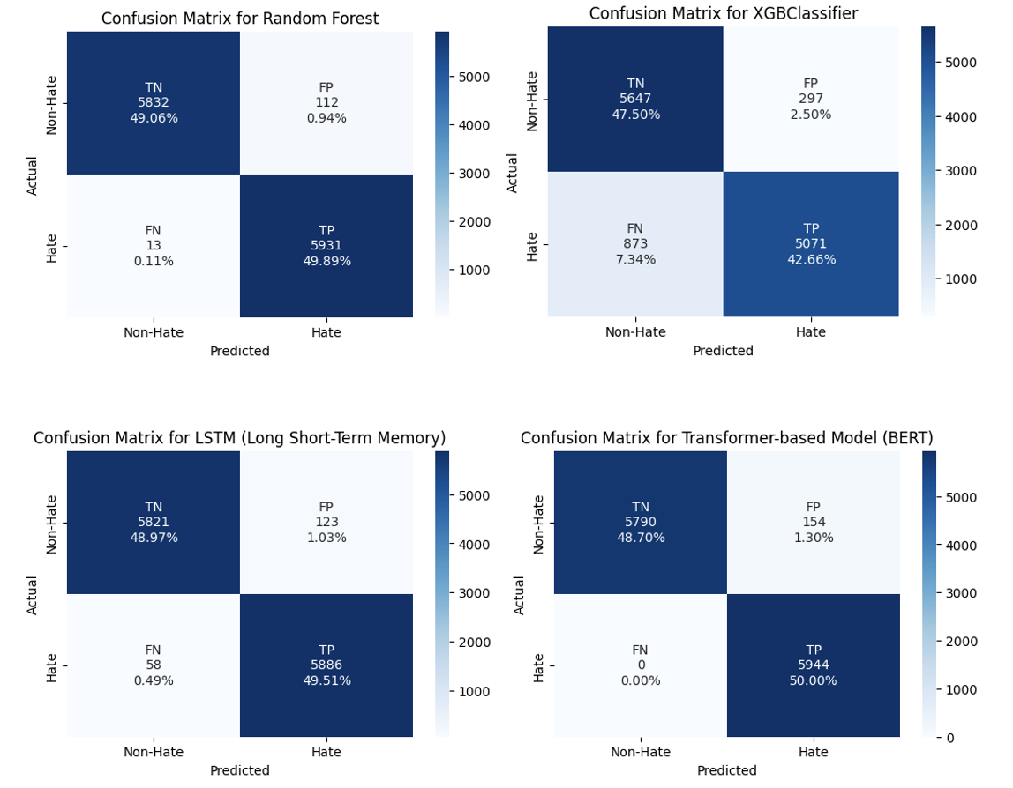
Confusion Matrix
The Random Forest performs best on predicting non-hate tweets, while the Transformer (fine-tune BERT) performs best on predicting hate tweets.

Slide 24
Accuracy, F1-Score, ROC-AUC Score
Model | Accuracy | F1-Score | ROC-AUC Score
Random Forest | 98.95% | 0.989527 | 0.989485
XGBClassifier | 90.96% | 0.896570 | 0.901581
LSTM | 98.48% | 0.984857 | 0.984775
Transformer (Fine-tune BERT) | 98.70% | 0.987211 | 0.987046
From the data above, Random Forest is the best performed model:
It has the highest accuracy (98.95%). Despite similar model performance of Transformer (fine-tune BERT), it needs more computing time and resources than traditional machine learning models.
It has the best trade-off between precision and recall, which means that it performs well in identifying hate tweets and correctly predicting non-hate tweets.
It has the highest ROC-AUC score, indicating that it has the best overall performance and discrimination capability of all four models we used.

Slide 25
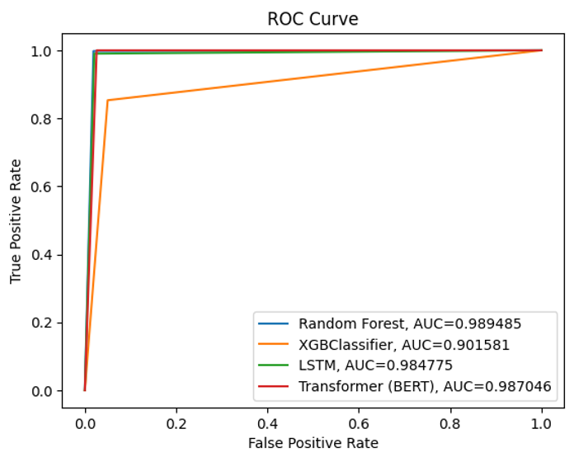
ROC Curve
The Random Forest model is represented by the blue line, which is overlapped with red line and green line. It has the largest AUC, proving its ability to distinguish between hate and non-hate tweets across different threshold settings.

Slide 26
Application Design
Deploy the ML model on Flask to create a web application
Running procedure

Slide 27
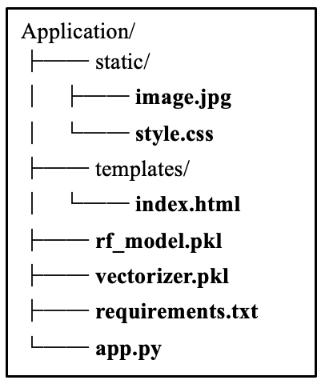
Deploy the ML model on Flask to create a web application
Workflow:
Application Files:
image.jpg: image shown on the website
style.css: the style of our web design
index.html: illustrate all the components on the front-end website
app.py: the Flask application code
requirements.txt: lists all the package needed to run the Flask web application
vectorizer.pkl: the TF-IDF vectorizer
rf_model.pkl: our pre-trained Random Forest model
Web Application
Input Text
Flask Server
Vectorize the input text
Prediction
Feed into the ML model

Slide 28

Run the app.py file on the terminal, and click the link of website in the output: http://127.0.0.1:5000/
Running Procedure:
Website Overview

Slide 29
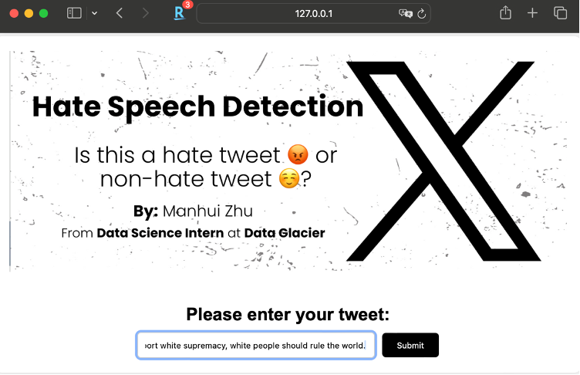
Running Procedure:
Enter Input Text
Enter a speech/tweet.
Example: I support white supremacy, white people should run the world

Slide 30
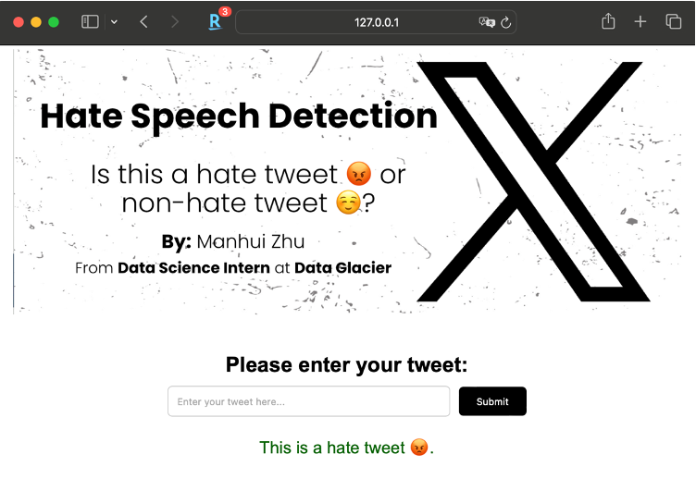
After clicking the ‘Submit’ button, the speech/tweet if first be passed through the TF-IDF vectorizer, then fitted into our ML model, and the classifier will output a result and display on the website.
Running Procedure:
Predict the Result

Slide 31
Conclusion
In this project, we try to build a model to detect the hate speech and non-hate speech and use the model to create the web application that can do the text classification on tweets.
We try 4 feature extraction methods: Bag of Words (BoW), TF-IDF, Word Embeddings (Word2Vec) and BERT.
We construct 4 models: Random Forest, XGBClassifier, LSTM, Transformer (Fine-tune BERT).
The best performing model is Random Forest model, the model accuracy reaches 98.95%. After save the model and TF-IDF vectorizer, we deploy our model on Flask to create a Web Application.
Given the error rate in the model and the limited text data, we will enhance our model performance by using more diverse data to train the model and customize the feature extraction method.

Slide 32
Reference
[1] Dataset: https://www.kaggle.com/datasets/vkrahul/twitter-hate-speech/code
[2] Hochreiter, S., & Schmidhuber, J. (1997). Long short-term memory. Neural Computation, 9(8), 1735-1780. DOI: 10.1162/neco.1997.9.8.1735
[3] Devlin, J., Chang, M. W., Lee, K., & Toutanova, K. (2019). BERT: Pre-training of deep bidirectional transformers for language understanding. arXiv preprint arXiv:1810.04805.

Slide 33
Thank You

